Slide 1
Programming in unity

Slide 2

Variables and types
Different types
String = “This is a string” (Just a bunch of letters in one place)
Int = 24 (Ints are whole numbers, negative or positive)
Float = 24.0f (Decimal point numbers)
Initialized like this:
int age = 22;
Variable type
Semicolon marks the end of a statement
Name of our variable
The value we declare

Slide 3
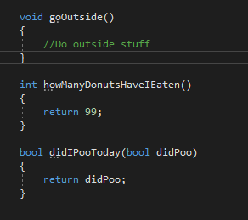
functions
Functions make the game go round!
We cannot make new functions inside of other functions
We can declare a function anywhere within our class, and there are a few different parts:
Private void myFunction()
{
// This is a comment
}
This is an access modifier.
Modifiers include private, protected, and public
Parentheses are our parameter list.
The value we want to return. Sometimes void, sometimes not.
The name of our function.
Comments are declared with // wherever you want to make a comment.
Curly braces mark the body of a function.

Slide 4

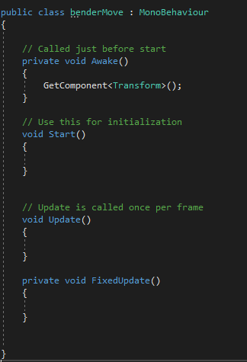
Unity functions
Awake() – The first function called on a GameObject when the game starts to play.
Start() – This function is called immediately after Awake if they are both included.
Update() – Gets called every frame, which can vary.
FixedUpdate() – Gets called every fixed frame, which in Unity is every 0.02 seconds.
GetComponent()<> - Looks for a component on the GameObject our script is attached to, and if it is found will return that component for us to modify as we wish!

Slide 5
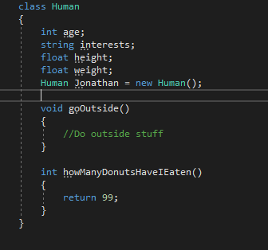
classes
Very important.
A class can be anything, including you!
Made with the ‘class’ keyword.
Usually contains variables, functions, and more!
We can use the ‘new’ keyword with a class to make an Object of that Class.

Slide 6
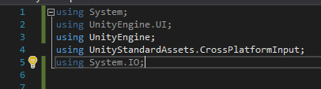
namespaces
Declared at the top of our files with the ‘using’ keyword.
Contains many useful classes, functions, and more!
using UnityEngine;
Ends with a semicolon.
Always starts with the ‘using’ keyword.
The name of the namespace we are using.

Slide 7
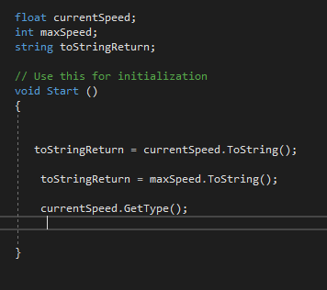
Accessing members of a class
How do we get functions and variables inside a class from a different class?
THE DOT OPERATOR (.)
The System namespace in C# comes with some useful functions for us to use already with any variable:
ToString()
GetType()

Slide 8
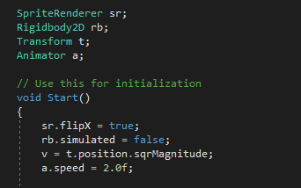
Unity classes
We have specific classes that are used in Unity to make games:
SpriteRenderer – These are used to display images of GameObjects we have in our scene in 2D.
Rigidbody2D – This gives our GameObjects physics capabilities in 2D.
Collider – The guts of a game, these are used to determine collisions between GameObjects
Transform – Comes with every GameObject, and defines the , , and scale of something.
Animator – Controls most aspects of animation that a GameObject uses such as states, transitions, and what animations to play at certain times.
position
rotation

